Slide 1
Grandview’s PARCC Presentation
October 14, 2014

Slide 2
Welcome!
Presenters
Meghan MacMillan
Regina Vassilatos
Kelly Nickels
Carolyn Romanoski
Raj Bansal
Schedule
Opening
Break out sessions- Language Arts, Math, Technology
Questions and Answers with Mrs. Carolyn Keck

Slide 3
Common Core
What?
a set of clear college- and career-ready standards for kindergarten through 12th grade in English language arts/literacy and mathematics
Who?
43 states including New Jersey have adopted the common core since 2010
Why?
With these high standards that are consistent across states,teachers, parents, and students have a set of clear expectations to ensure that all students have the skills and knowledge necessary to succeed in college, career, and life upon graduation from high school, regardless of where they live

Slide 4
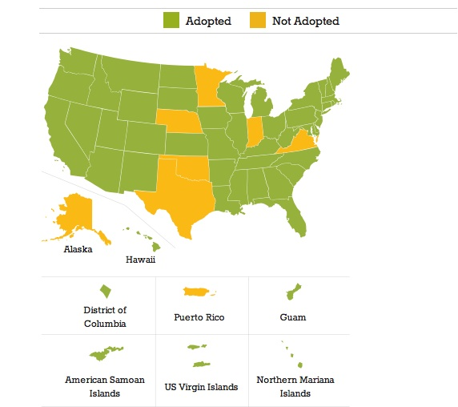

Slide 5
Video
http://www.corestandards.org/what-parents-should-know/

Slide 6
PARCC
PARCC= The Partnership for Assessment of Readiness for College and Careers
The PARCC is aligned to the common core
Math- require students to solve problems using mathematical reasoning and to be able to model mathematical principles
Literacy- students will be required to closely read multiple passages and to write essay responses in literary analysis, research tasks and narrative tasks

Slide 7
2 Parts of PARCC
Performance Based Assessment (PBA)
20 day window (March 2-27)
ELA- 1-2 days of testing
Math- 2 days with 50 minutes of testing each day
End of Year (EOY)
April 27th- May 22nd
ELA- 2 days with 50-85 minutes of testing each day
Math- 2 days with 50-65 minutes of testing each day

Slide 8
Performance Based Assessment
Take place after 75% of the school year
Will contain extended tasks and application concepts and skills (problem solving) NOT straight responses.
ELA- will ask students to write effectively when analyzing text/research simulation
Math- will ask students to solve multistep problems requiring abstract reasoning, precision, perseverance, and strategic use of tools

Slide 9
End of Year
Take place after 90% of school year
ELA will ask students to complete short answer items and reading comprehension
Math will ask students to solve short items that address concepts and skills

Slide 10
PARCC vs. Traditional Assessments
In ELA/literacy, the PARCC assessments will look much deeper at student writing abilities and critical-thinking skills
In math, students will have to solve complex problems, show their work, and demonstrate how they solved the problem
PARCC will more closely resemble high-quality classroom work. PARCC will measure what children are learning, in a more meaningful way.
PARCC’s estimated testing time is reasonable
PARCC is designed to measure the full range of knowledge and skills students need to be career and college ready or on track toward that goal, through performance based tasks

Slide 11
PARCC vs. Traditional Assessments Continued
PARCC is innovative in design and more engaging for students
PARCC will produce a clearer and more accurate picture of student achievement

Slide 12
Sample Questions

Slide 13
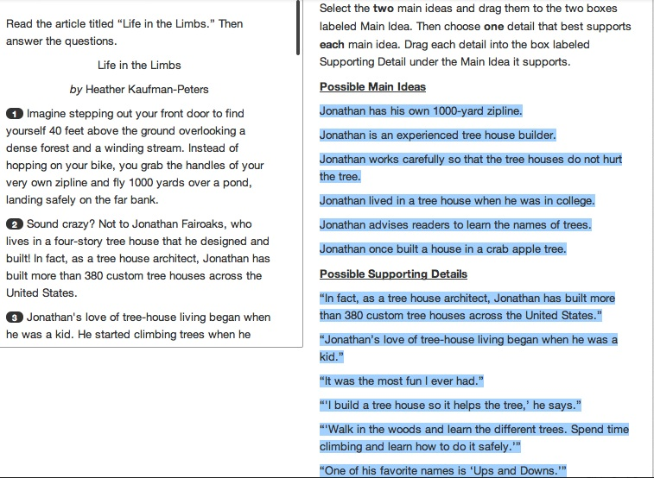

Slide 14
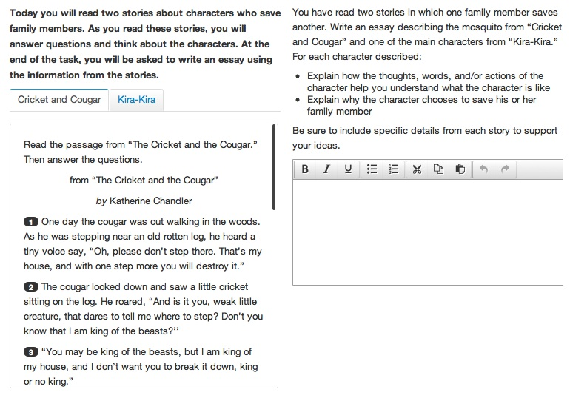

Slide 15
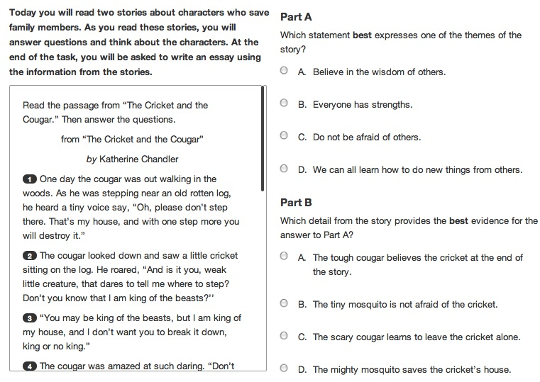

Slide 16
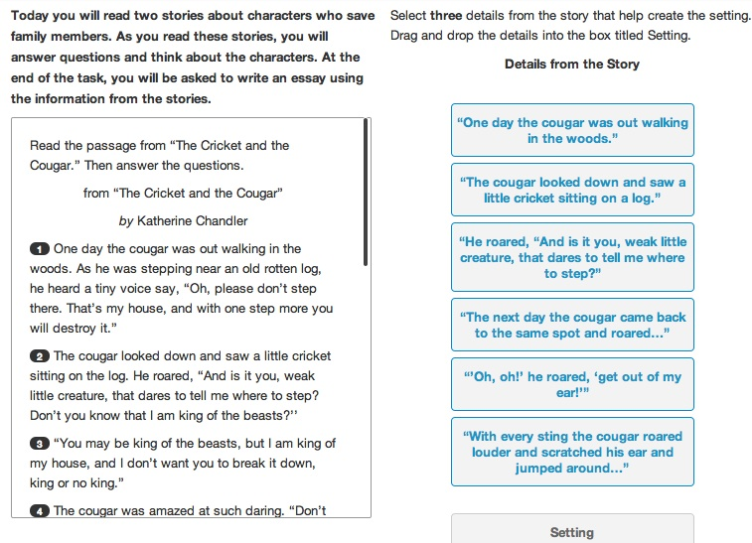

Slide 17
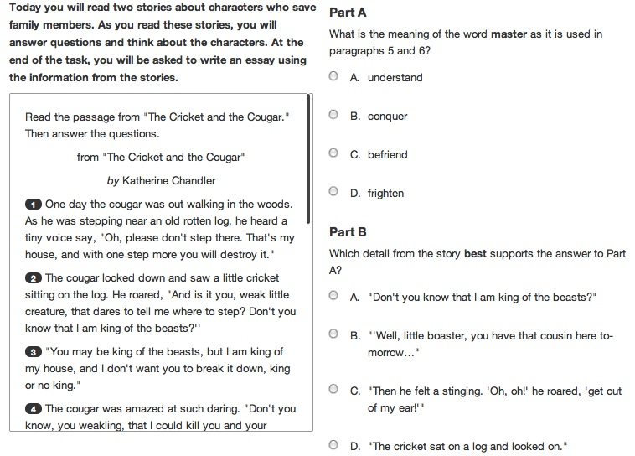

Slide 18
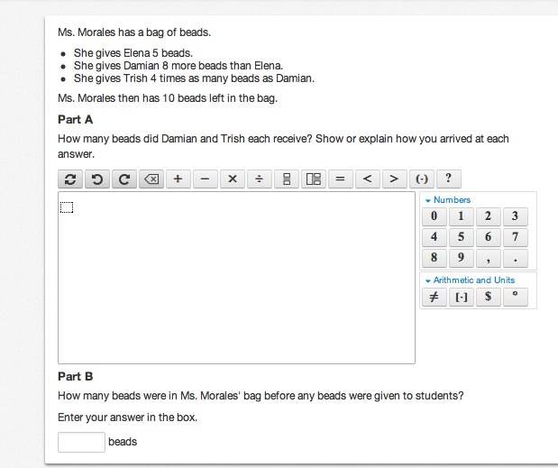

Slide 19
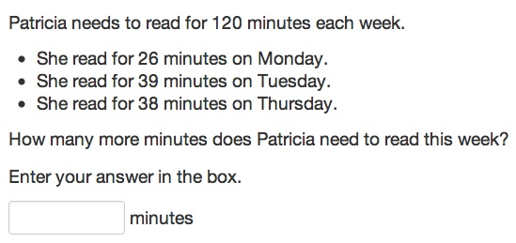

Slide 20
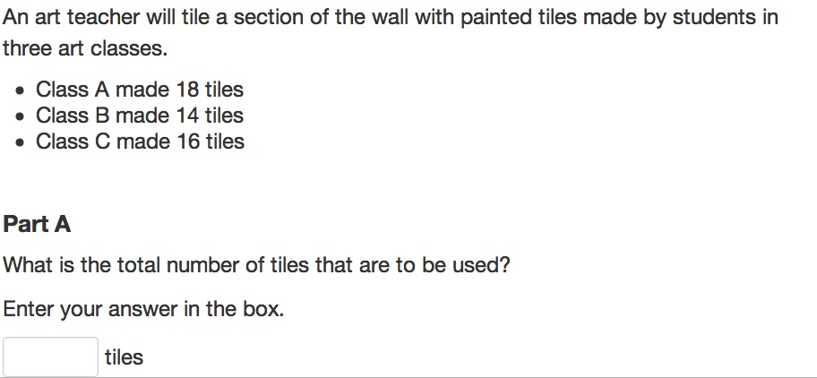

Slide 21
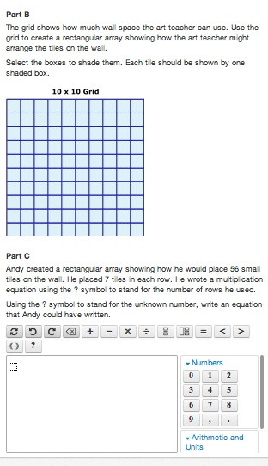

Slide 22
Wrap Up
There will be little/no data from this year, data will be accessible in 2015/16
PARCC website- We have not adopted all parts of the PARCC so be careful on the website
Rubrics- They are changing the levels of proficiency (4 or 5?)
As soon as information is released, we will update you
Nov 12th- Piscataway HS PARCC session #2

Slide 23
Helpful Websites
http://piscatawayschools.org/parent_center/common_core_corner
http://www.state.nj.us/education/sca/parcc/
http://www.parcconline.org/samples/mathematics/grade-3-mathematics
http://www.parcconline.org/samples/english-language-artsliteracy/grade-3-elaliteracy

